Slide 1


Marco Thielmann
13-Jun-2022

Slide 2
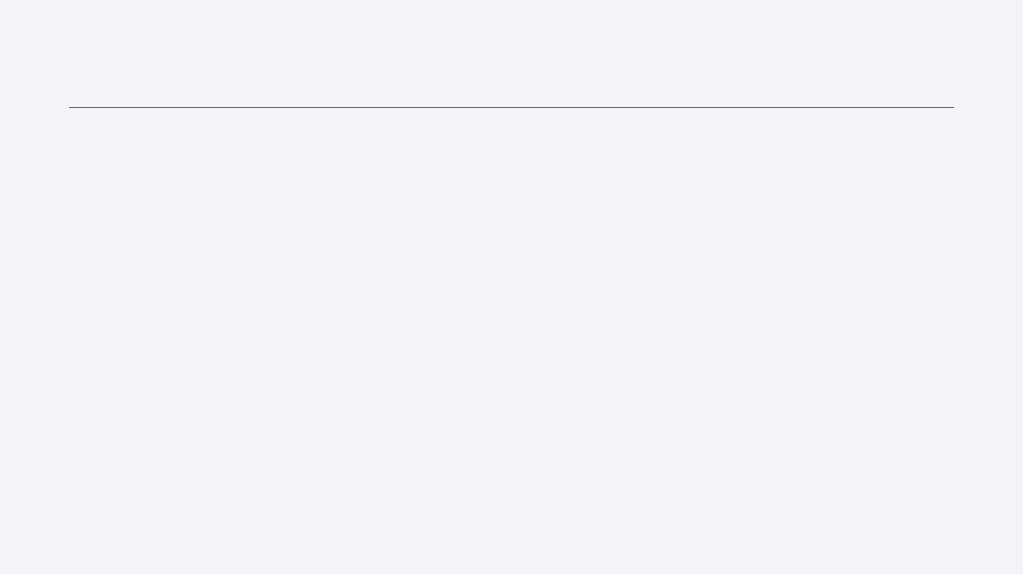
Outline
Executive Summary
Introduction
Methodology
Results
Conclusion
Appendix

Slide 3
Executive Summary
Summary of methodologies
Summary of all results

Slide 4
Introduction
Project background and context
Space X advertises Falcon 9 rocket launches on its website with a cost of 62 million dollars; other providers cost upward of 165 million dollars each, much of the savings is because Space X can reuse the first stage. Therefore, if we can determine if the first stage will land, we can determine the cost of a launch. This information can be used if an alternate company wants to bid against space X for a rocket launch. This goal of the project is to create a machine learning pipeline to predict if the first stage will land successfully.
Problems you want to find answers
What factors determine if the rocket will land successfully?
The interaction amongst various features that determine the success rate of a successful landing.
What operating conditions needs to be in place to ensure a successful landing program.

Slide 5

Section 1

Slide 6
Methodology
Executive Summary
Data collection methodology:
Data was collected using SpaceX API and web scraping from Wikipedia.
Perform data wrangling
One-hot encoding was applied to categorical features and missing values were calculated using existing data
Perform exploratory data analysis (EDA) using visualization and SQL
Perform interactive visual analytics using Folium and Plotly Dash
Perform predictive analysis using classification models
How to build, tune, evaluate classification models

Slide 7
Data Collection
Data was collected using the SpaceX API
Data collection was done using get request to the SpaceX API.
Next, we decoded the response content as a Json using .json() function call and turn it
into a pandas dataframe using .json_normalize().
We then cleaned the data, checked for missing values and fill in missing values where necessary.
In addition, we performed web scraping from Wikipedia for Falcon 9 launch records with BeautifulSoup.
The objective was to extract the launch records as HTML table, parse the table and convert it to a pandas dataframe for future analysis.
You need to present your data collection process use key phrases and flowcharts

Slide 8
Data Collection – SpaceX API
1. Get request for rocket launch data using API:
spacex_url=https://api.spacexdata.com/v4/launches/past
response=requests.get(spacex_url)
Read JSON
Static_json_df = res.json()
Normalize data:
data=pd.json_normalize(response.json())
Extract column names:
column_names=[]table_columns=first_launch_table.find_all('th')forcolumnintable_columns:name=extract_column_from_header(column)ifnameisnotNoneandlen(name)>0:column_names.append(name)
Convert to dataframe: df=pd.DataFrame(launch_dict)
We used the get request to the SpaceX API to collect data, clean the requested data and did some basic data wrangling and formatting.
Notebook URL: https://github.com/MarcoThielmann/SpaceY/blob/85acb4ba464dfe5663708c96ad3bdbd2ed1ce0da/jupyter-labs-spacex-data-collection-api.ipynb

Slide 9
Data Collection - Scraping
Get Wikipedia page:
static_url=https://en.wikipedia.org/w/index.php?title=List_of_Falcon_9_and_Falcon_Heavy_launches&oldid=1027686922
html=requests.get(static_url)
Create BeautifulSoup object:
soup=BeautifulSoup(html.content,"html.parser")
Extract HTML table data and convert to dataframe:
html_tables=soup.find_all("table")
column_names=[]table_columns=first_launch_table.find_all('th')forcolumnintable_columns:name=extract_column_from_header(column)ifnameisnotNoneandlen(name)>0:column_names.append(name)
We applied web scrapping to Falcon 9 launch records using BeautifulSoup
We parsed the table and converted it into a pandas dataframe.
Notebook: https://github.com/MarcoThielmann/SpaceY/blob/85acb4ba464dfe5663708c96ad3bdbd2ed1ce0da/jupyter-labs-webscraping.ipynb

Slide 10
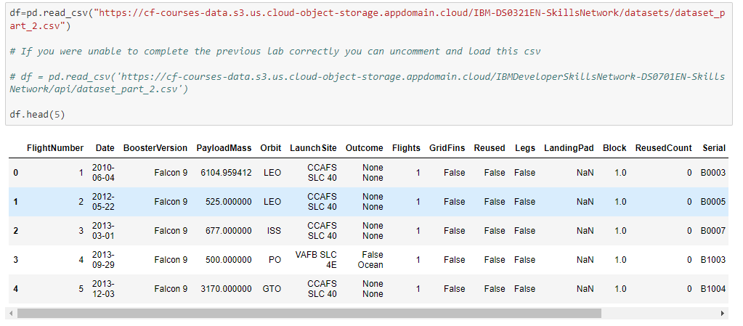
EDA with Data Visualization
Read SpaceX dataset into dataframe:

Slide 11
EDA with Data Visualization
Find relations between different data points, such as
Flight Number and Launch Site
Payload and Launch Site
Success rate of each orbit type
Flight Number and orbit type
Payload and orbit type and
Calculating a yearly trend

Slide 12
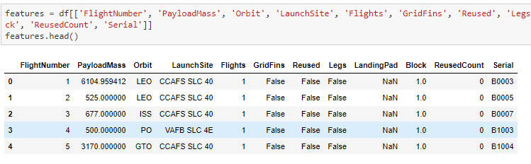
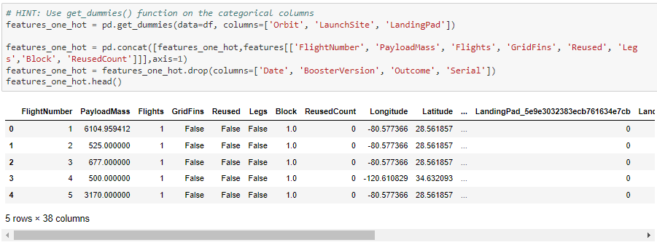
EDA with Data Visualization
Features Engineering
Select features that will be used for prediction
Create dummy variables to categorical columns
Apply hot encoding

Slide 13
Predictive Analysis methodology
Create a column for the class
Standardize the data
Split into training data and test data
Find the best Hyperparameter for SVM, Classification Tree and Logistic Regression
Find the method that performs best using test data

Slide 14

Section 2

Slide 15
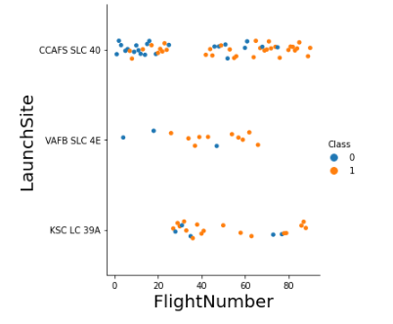
Flight Number vs. Launch Site

Slide 16
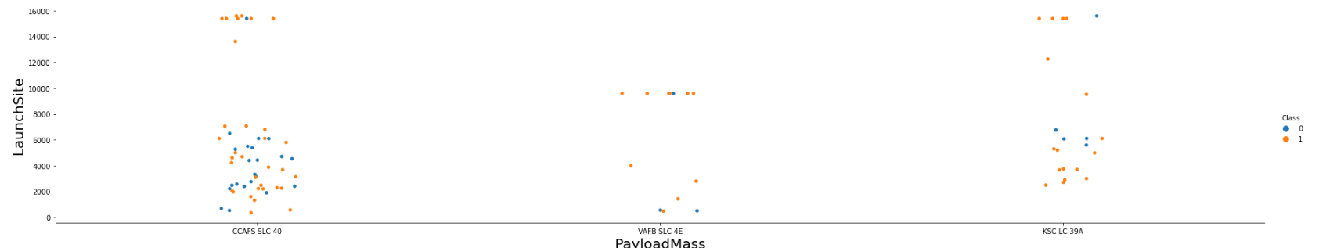
Payload vs. Launch Site

Slide 17
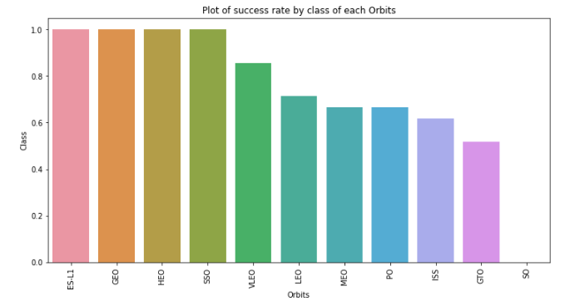
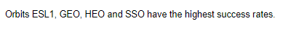
Success Rate vs. Orbit Type

Slide 18
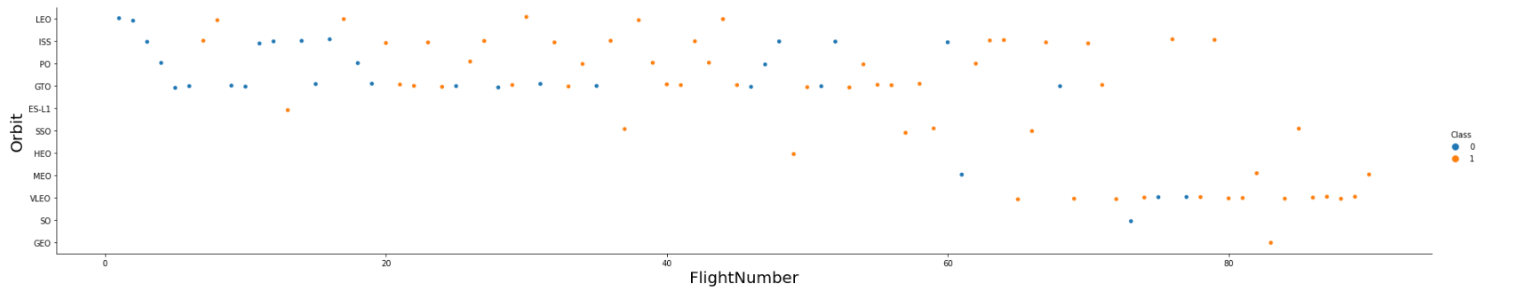
Flight Number vs. Orbit Type

Slide 19
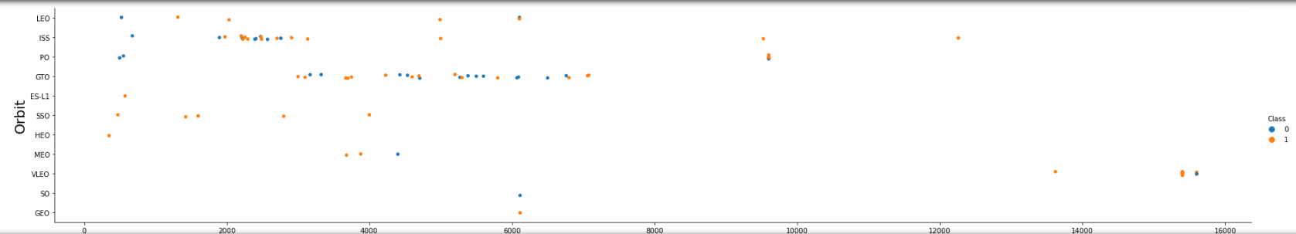
Payload vs. Orbit Type

Slide 20
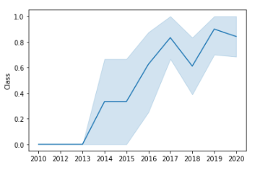
Launch Success Yearly Trend

Slide 21
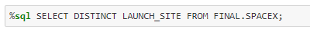
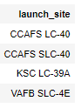
All Launch Site Names
There are 4 different launch sites:
CCAFS LC-40
CCAFS SLC-40
KSC LC-39A
VAFB SLC-4E
We used the key word DISTINCT to show only unique launch sites from the SpaceX data:

Slide 22
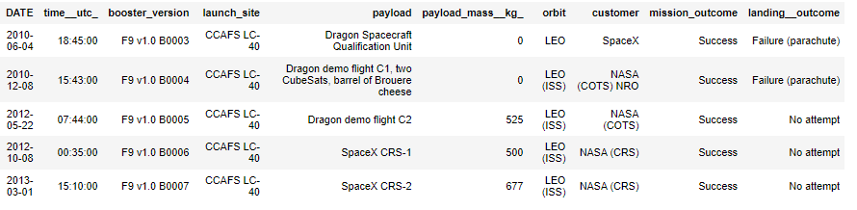
Launch Site Names Begin with 'CCA'
Result was retrieved by using the LIKE keyword and limit the results to a total of 5:

Slide 23
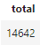
Total Payload Mass
Total Payload Mass was calculated using the SUM command:

Slide 24
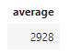
Average Payload Mass by F9 v1.1
The average payload mass for the Booster version F9 v1.1 was 2928.
The AVG keyword was used for entries that have the requested booster version.

Slide 25
First Successful Ground Landing Date
The first successful ground landing was on the 08-Jan-2018.
The result was retrieved by retrieving data with a successful landing outcome, ordering the results descending by data and limiting the result to 1

Slide 26
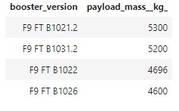
Successful Drone Ship Landing with Payload between 4000 and 6000
The booster versions on the right side had a successful drone ship landing with a payload between 4000 and 600:
They were identified by looking for DISTINCT booster versions with a successful landing outcome and a payload mass between 4000 and 6000

Slide 27
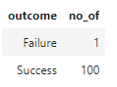
Total Number of Successful and Failure Mission Outcomes
Only one failure and 100 successful mission outcomes were identified.
To get the information we used a subquery to get all successful landings as success and all others as failure and made it available as outcome. The result was grouped by outcome and counted:

Slide 28
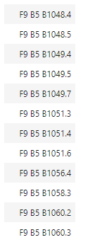
Boosters Carried Maximum Payload
These boosters have carried the maximum payload:
F9 B5 B1048.4
F9 B5 B1048.5
F9 B5 B1049.4
F9 B5 B1049.5
F9 B5 B1049.7
F9 B5 B1051.3
F9 B5 B1051.4
F9 B5 B1051.6
F9 B5 B1056.4
F9 B5 B1058.3
F9 B5 B1060.2
F9 B5 B1060.3
The data was retrieved by identifying the max payload mass in a subquery and selecting the distinct booster versions that have an entry for that payload mass.

Slide 29
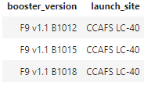
2015 Launch Records
Below you can find the launch sites and the booster versions that had a failed landing outcome in 2015:
The information was retrieved using data from the year 20015 that have ‘drone’ in their landing outcome, using the LIKE command:

Slide 30
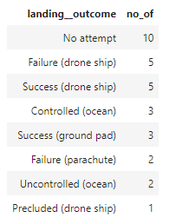
Rank Landing Outcomes Between 2010-06-04 and 2017-03-20
There were 10 launches were no attempt was taken to land
The highest success was via drone ship, closely followed by landing on the ground pad

Slide 31

Section 3

Slide 32
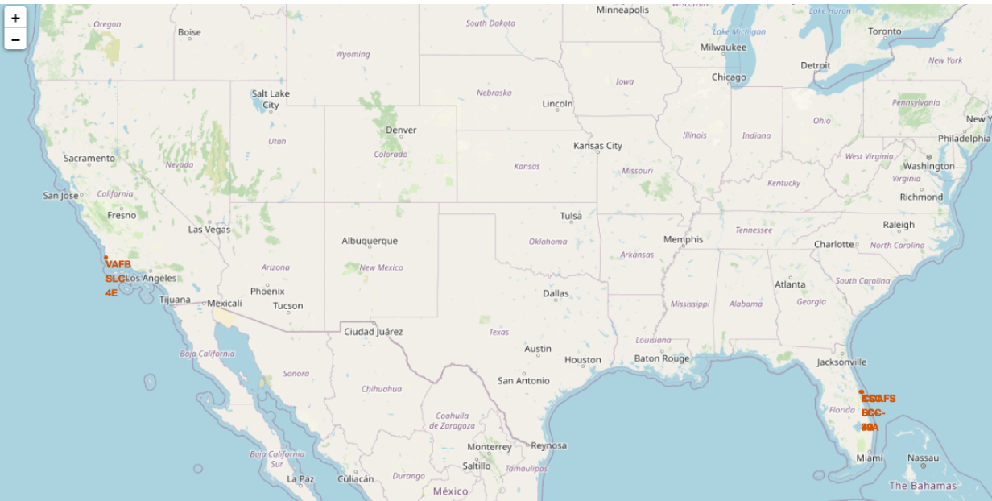
Launch Site Locations
All launch sites were located near the costal area of the USA in the states Florida and California

Slide 33
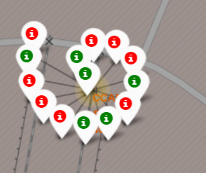
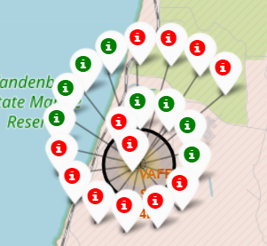
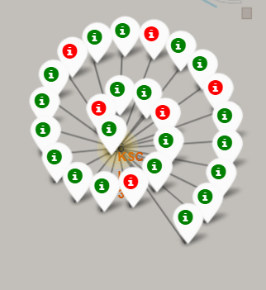
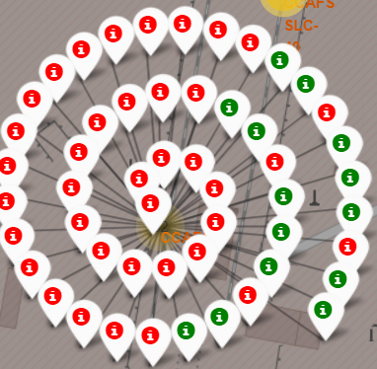
Successful vs Failed Launches
Florida
California
CCAFS SLC40
KSC-LC 39A
CCAFS LC40
Highest changes of success were at site KSC-LC 39A
CCAFS LC40 had the highest failure rate

Slide 34
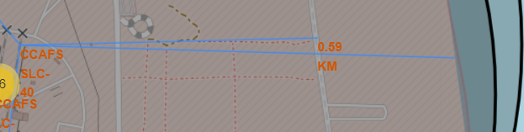
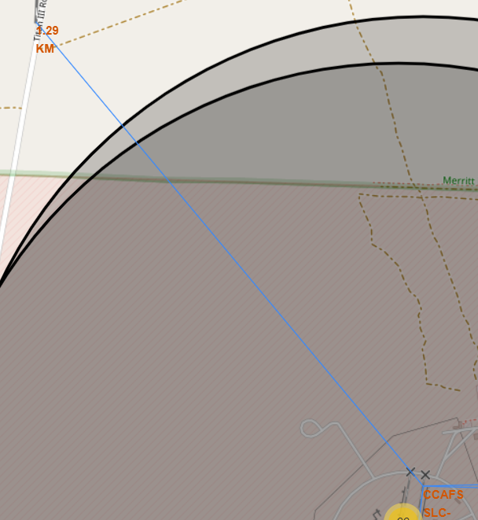
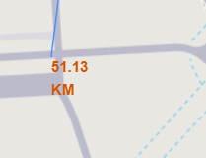
Distance to landmarks
Launch sites were close to coastlines
No close proximity to highways and railways
Far off from big cities

Slide 35

Section 4

Slide 36

Success by all sites
Replace <Dashboard screenshot 1> title with an appropriate title
Show the screenshot of launch success count for all sites, in a piechart
Explain the important elements and findings on the screenshot

Slide 37

Launch site with the highest success ratio

Slide 38
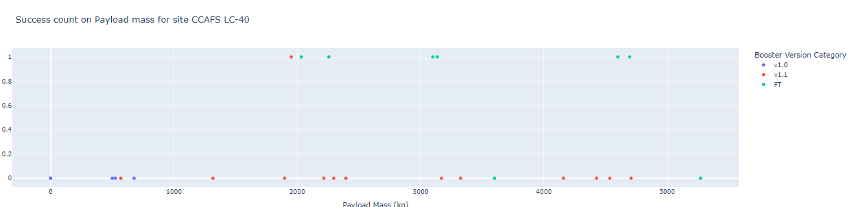
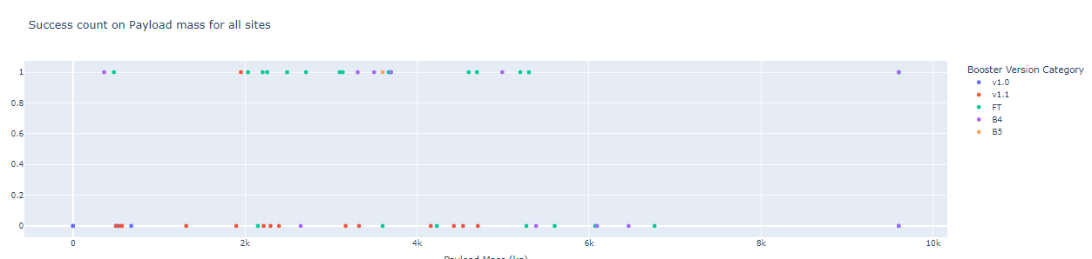
Success count Best performing site vs All sites

Slide 39

Section 5

Slide 40
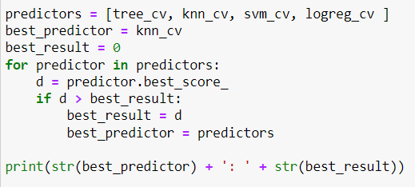
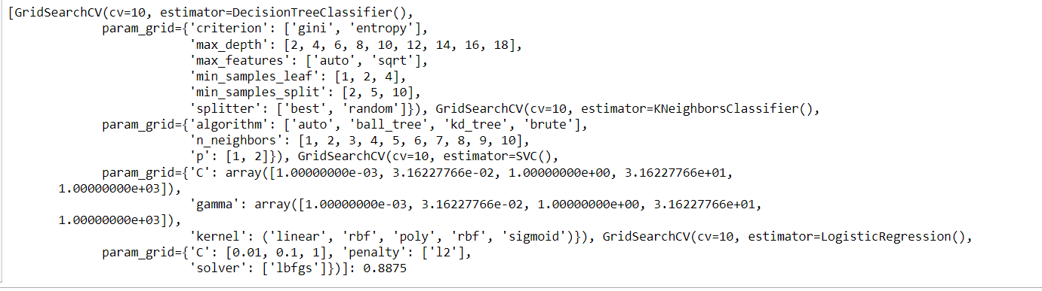
Classification Accuracy
The decision tree classifier is the modle with the highest classification accuracy:

Slide 41
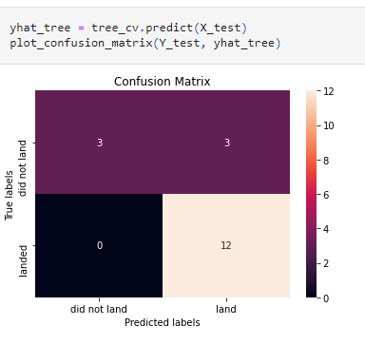
Confusion Matrix

Slide 42
Conclusions
The higher the amount of flights at a launch site, the better is the success rate
Launch success rate is increasing since 2013 until 2020
Orbits ES-L1, GEO, HEO, SSO, VLEA had the highest success rate
KDC LC-39A had the most successful launches of any site
The DecisionTree classifier is the best machine learning algorithm for this task.

Slide 43
Appendix
All sources can be found on github:
https://github.com/MarcoThielmann/SpaceY

Slide 44


